Slide 1
Cornell SEBA
Science and
Engineering
Business
Association
General Body Meeting
February 15, 2012

Slide 2
Who we are
Undergraduate students
Science and Engineering majors
Interested in business, finance, and management
Pursing careers in related fields

Slide 3
Mission Statement
The mission of the SEBA is to provide a richer and fuller educational experience for undergraduate students by offering members a chance to learn about the business and management disciplines

Slide 4
Calendar
Feb 22- Elevator Pitches
Feb 29- Case Studies
Mar 7- MBA Panel
Mar 14- Sectors of Finance
Mar 28- Guest Speaker

Slide 5
Calendar
April 4- Mock Interviews
April 11- Guest Speaker
April 18- Student Panel
April 25- Investing
Social Events
Networking Sessions

Slide 6
Current events

Slide 7
Recent News
Not a whole lot
Apple- Fair Labor Association
Counterfeit Cancer Drugs

Slide 8
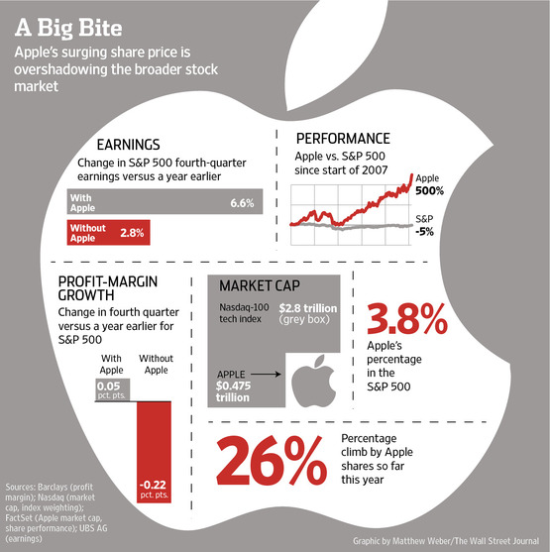
Apple
Notes:
Fired 90% of employees

Slide 9
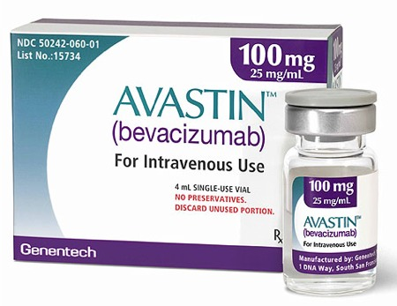
Avastin

Slide 10
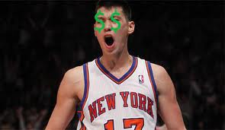
Jeremy lin
Notes:
Retail investors have a high demand of such a successful and common company.
simple supply and demand curve, an increase in demand causes an outward shift in the demand curve raising prices.
The current winner in the race for Facebook equity, with nearly $500 million, is Russian entrepreneur Yuri Milner, head of investment group DST.
Ipo’s are just a way for companies to raise capital for future projects.
Attracting better employees with stock options.
According to a Washington post this may change the culture of the company from one focusing on “connecting people” as facebook was originally intended, to one focused on making good quarterly reports

